Slide 1
Fundamental Concepts

Slide 2
Outline
Fluid as a continuum
Density
Velocity field
Stress field
Viscosity
Surface tension
Description and classification of fluid motions

Slide 3
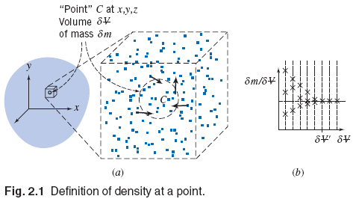


Fluid as a continuum
Continuum → smooth continuous medium
Basis of classical fluid mechanics
Assumption is not valid in rarefied gas flow, etc.

Slide 4
Some important properties of a fluid
Density – Mass per unit volume
For ideal gases
Specific volume
Specific weight
Specific Gravity (SG)
Vapor pressure
Notes:
Specific weight → It is the weight of a substance per unit volume (=density * gravity)
Vapor pressure → The pressure exerted by its vapor in phase equilibrium with its liquid at a given temperature.

Slide 5


Velocity Field
Very important property
Time rate of change of position vector
Steady / unsteady flow
Properties at every point in the flow field do not change with time – “Steady flow”
Properties are varying with time in the flow field – “Unsteady flow”

Slide 6
Velocity Field
1-D, 2-D and 3-D flows
No of space coordinates required to specify the velocity field
Uniform flow at a given cross section
Velocity is constant across any section normal to the flow
Uniform flow field
Velocity is constant in the flow field (velocity is independent of space coordinates throughout the entire flow field)

Slide 7
Timelines, Pathlines, Streaklines and Streamlines
Visual representation of a flow
Timeline
Adjacent fluid particles in a flow field are marked at a given instant of time → Formed line is “Timeline”
Pathline
Path or trajectory traced out by a moving fluid particle
OR
Line traced out by a given particle as it flows from one point to another

Slide 8
Timelines, Pathlines, Streaklines and Streamlines
Streakline
Locus of the positions of the fluid particles, at a particular instant, which have passed through a same fixed point
It consists of all particles in a flow that have passed through a common point
Streamline
A line that is everywhere tangent to the velocity field
Streamlines are tangent to the direction of flow at every instant
Fluid cannot cross the streamline
Streamtube – bundle of streamlines

Slide 9
Timelines, Pathlines, Streaklines and Streamlines
http://en.wikipedia.org/wiki/File:Streaklines_and_pathlines_animation_(low).gif
http://www-mdp.eng.cam.ac.uk/web/library/enginfo/aerothermal_dvd_only/aero/fprops/cvanalysis/node8.html
Example 2.1

Slide 10
Timelines, Pathlines, Streaklines and Streamlines
Streamlines, streaklines and pathlines are identical for steady flows
For unsteady flows, these lines have different shapes

Slide 11
Stress field
Forces on a fluid particle
Surface forces – Pressure, friction
Body forces – Gravity, electromagnetic
Surface forces → stresses
Generated by motion in fluids
Concept of stress in a continuum
Normal stress
Shear stress

Slide 12
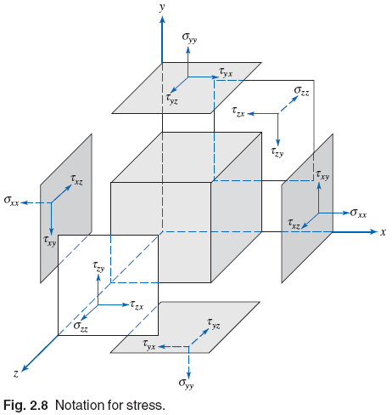
Stress field
Stress components
State of a stress at a point
Can be described completely by specifying the stresses acting on any three mutually perpendicular planes through the point.
Sign convention

Slide 13
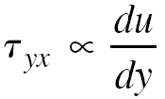
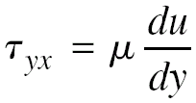
Viscosity
Deformation of a fluid particle/element
Relation between applied shear stress and deformation rate (shear rate)
Newtonian fluids (Newton’s law of viscosity)
Most of the common fluids (water, air, oil, etc.)
Viscosity → resistance to the flow of fluid (friction)
Units – Pa.s, poise (g/cm.s)
Notes:
Drag force → The force a flowing fluid exerts on a body in the flow direction

Slide 14
Viscosity
Kinematic viscosity
Ratio of absolute viscosity to density
Units – m²/s, stoke (cm²/s)
Effect of temperature on viscosity of fluid
Gas viscosity → increases with increase in temp.
Liquid viscosity → decreases with increase in temp.
Example 2.2

Slide 15
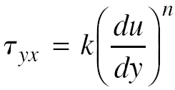
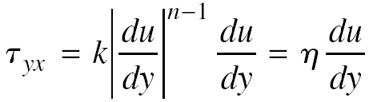
Viscosity
Non-Newtonian fluids
Special fluids (e.g., most biological fluids, toothpaste, some paints, etc.)
“Non-linear” fluids
Power law (One dimensional form)
Apparent viscosity

Slide 16
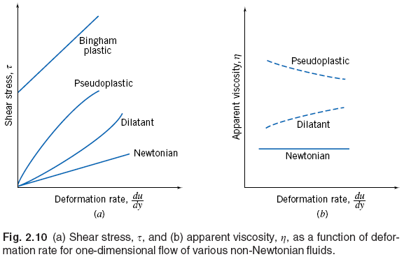
Viscosity
Non-Newtonian fluids (Time independent)
Apparent viscosity may be time dependent
Thixotropic fluids (viscosity decreases with time)
Rheopectic fluids (viscosity increases with time)

Slide 17
Surface tension
Wetted/non-wetted surface
Surface tension
Created due to unbalanced cohesive forces experienced by molecules along the surface
The intensity of molecular attraction per unit length along any line in the surface is called “surface tension”
Unit of σ → N/m

Slide 18
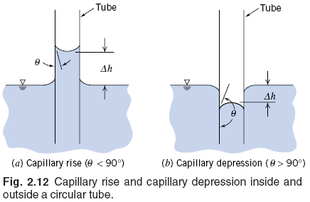
Surface tension
Capillary rise/ capillary depression
Surfactants – compounds reduces surface tension significantly.

Slide 19
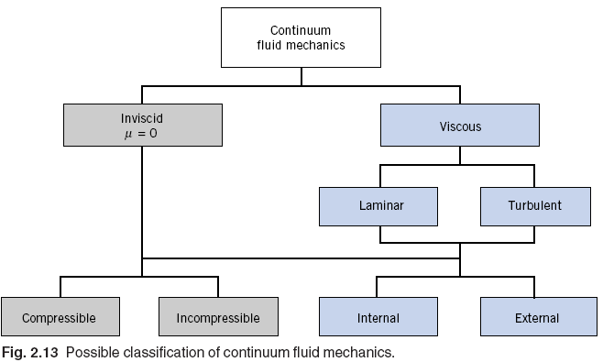

Description and classification of fluid motions
Reynolds No
Mach No

Slide 20
Example-1
The velocity for a steady incompressible flow on the xy plane is given by V=(A/x)i+(Ay/x²)j, where A=2m²/s and the coordinate are measured in meters.
Obtained the equation for streamline that passes through the point (x, y) = (1, 3).
Determine the velocity of particle at (x, y)=(1, 3)
Obtain the equation for the path line.
Calculate the time required for a fluid particle to move from x = 1m to x =2m in the flow field

Slide 21
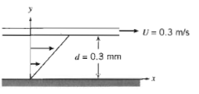
Example- 2
A infinite plate is over a second plate on a layer of liquid as shown. For small gap width “d”, we assumed a linear velocity distribution in the liquid. The liquid viscocity is 0.65 centipoise and specific gravity is 0.88. Determine :
the momentum diffusivity of the liquid
The shear stress on the upper plate
The shear stress in the lower plate
The direction of each shear stress

Slide 22
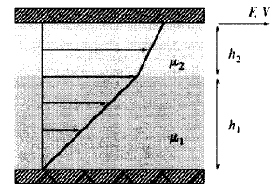
Example -3
Fluid of viscosity µ₁=0.1 N.s/m² and µ₂=0.15 N.s/m² are contained between two plates (each plate is 1 m² in area). The thickness h₁=0.5mm and h₂=0.3 mm respectively. Find the force F to make the upper plate move at a speed of 1m/s. what is the fluid velocity at the interface between the fluids

